Slide 1

Recommender
Book Blurb Recommendation System
Find your Book
This project develops an intelligent book recommender system using NLP to analyze book blurbs, addressing the challenge of finding the ideal book by leveraging this valuable yet often-overlooked information source.

Slide 2
Team Project
Name | ID
Samaa Khaled Mohamed | 222100761
Habiba Ahmed Abdelnapy | 222100471
Youssef Husseiny Fathy | 222101943
Mohammed Desoky Ibrahim | 222101362
Nada Gamal Ibrahim | 222101750

Slide 3
Traditional Methods
Our Approach
Traditional methods rely on lengthy and detailed descriptions, which can be time-consuming and inefficient.
Our approach extracts key features from the concise yet insightful blurb, which often highlights the main characters and driving conflicts of the story.

Slide 4
Project Features
Interface Design | Backend Implementation
This project includes an intuitive user interface developed using HTML and CSS. The interface allows users to interact seamlessly with the backend, facilitating data input, parameter selection, and results visualization. | The backend is implemented using Django, leveraging its powerful web framework capabilities for handling computations, data transformations, and result generation. Django's scalability ensures that the pipeline can handle large datasets efficiently.

Slide 5
Data Preprocessing
01
02
03
Data cleaning & Tokenization
Stop word Removal & Lemmatization
Converted text to lowercase, removed non-alphanumeric characters, and tokenized the text using NLTK to prepare for further analysis.
Removed stop words from texts longer than five words and applied lemmatization to reduce words to their base forms using WordNetLemmatizer.
Language Translation & Text Improvement
Translated non-English descriptions into English using Google Translate and improved short or incomplete descriptions by augmenting them with book titles

Slide 6
Methodology
Column Selection
Missing Data Handling
Deduplication
Text Cleaning
Non-essential columns like book_format, book_authors, and book_isbn were removed to simplify the dataset. This allowed us to focus on more important details such as book descriptions and titles.
Missing descriptions were replaced with the book titles. This made sure that no book entry was left incomplete and that each book had a description.
Duplicate book titles were removed to prevent repetition. Then, descriptions were combined using the group by function to ensure each book had one clear description.
The text was changed to lowercase for consistency. Non-alphanumeric characters were removed, and the text was tokenized using NLTK to break the descriptions into smaller parts for easier processing.

Slide 7
Methodology
Stopword Removal
Lemmatization
Language Translation
Text Improvement
Stopwords were removed from descriptions longer than five words using the NLTK library. This helped get rid of common, unimportant words, making the text cleaner and more useful
Words in the descriptions were lemmatized to their base forms using the WordNetLemmatizer. This helped simplify words to their root forms, making the text more consistent and improving the analysis.
Non-English descriptions were translated into English using Google Translate. Language detection made sure that numeric or non-linguistic texts were not mistakenly translated, keeping the dataset consistent.
Short or incomplete descriptions were expanded with book titles to give more context. Descriptions were also cleaned by removing unnecessary patterns, like excessive punctuation, to make them easier to read.

Slide 8
Feature Extraction
TF-IDF Vectorization
Sentence Embedding
TF-IDF vectorization was used on the cleaned descriptions to turn the text into numerical data. The settings were adjusted to include up to 10,000 features and to filter out irrelevant terms based on document frequency.
The Sentence Transformer model, all-mpnet-base-v2, was used to convert book descriptions into high-dimensional vectors. This made it possible to efficiently compare the meanings of descriptions using cosine similarity.

Slide 9
Recommendation Algorithms
Cosine similarity-Based
Transformer-Based
User-provided blurbs were cleaned and vectorized using the same preprocessing steps as the dataset. Cosine similarity was calculated between the user's vector and all book vectors, and the top N books with the highest similarity scores were recommended.
The Sentence Transformer model encoded the user’s blurb into an embedding vector. Cosine similarity was calculated between the user’s embedding and the book embeddings, and books were ranked by similarity scores, with the top N results chosen for recommendation.

Slide 10

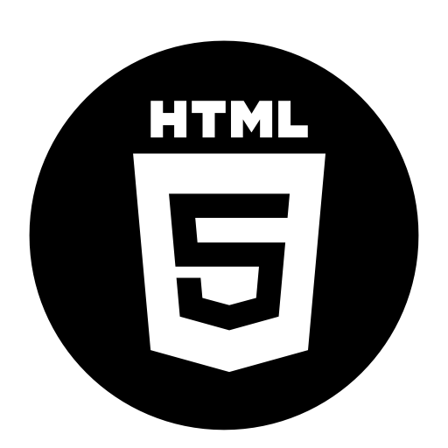

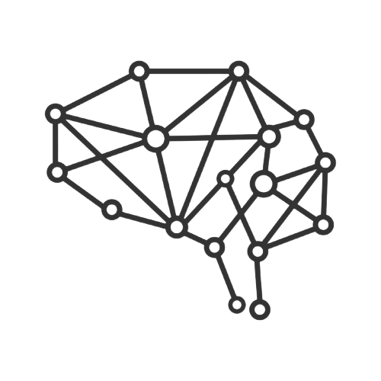

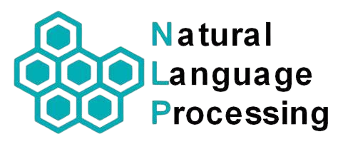
Technologies Used
Characters:
HTML
CSS
JavaScript
Django
NLP
Deep Learning
Fields Covered:
Front End
Natural Language Processing
Backend
Deep Learning (Transformers)

Slide 11
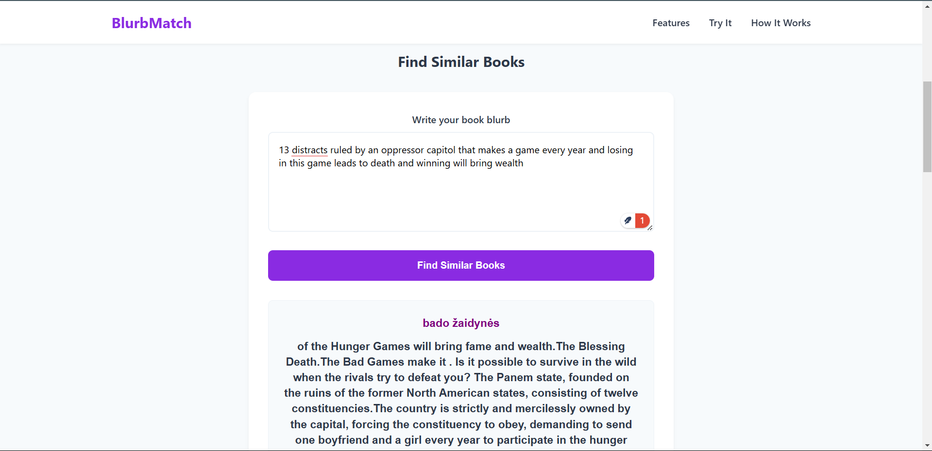
Website

Slide 12
Results and Evaluation
01
02
03
Improved Data Quality
Faster Processing
Automated preprocessing tasks to reduce processing time for large datasets.
Consistent cleaning and error handling enhanced data integrity
Better Model Results
Preprocessing led to higher performance metrics in Deep learning models

Slide 13
Conclusion
This project combines an HTML/CSS interface with a Django backend and uses NLP to analyze text. It provides an efficient book recommendation system by extracting key features from book blurbs, automating data preprocessing, and offering scalable solutions for both small and enterprise-level needs.

Slide 14
Thanks!

